Slide 1
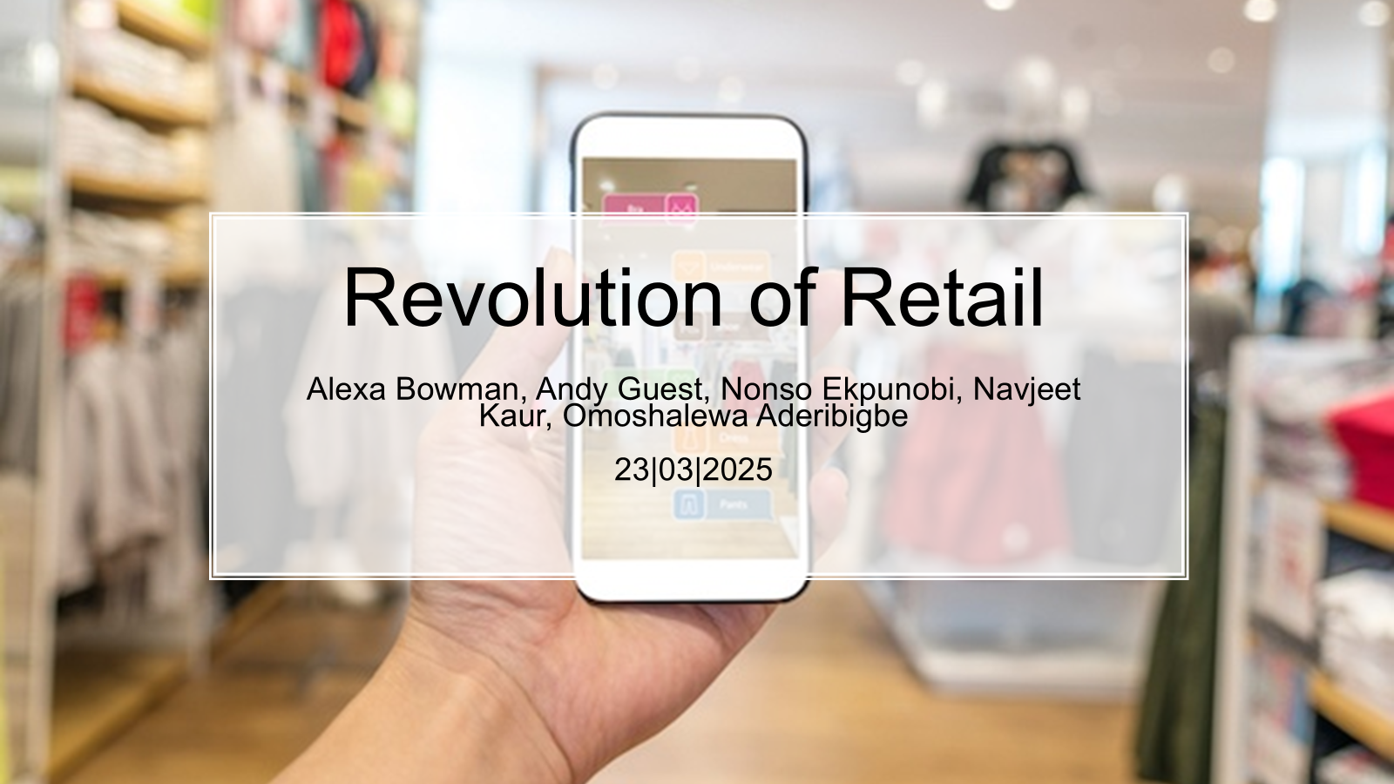
Revolution of Retail
Alexa Bowman, Andy Guest, Nonso Ekpunobi, Navjeet Kaur, Omoshalewa Aderibigbe
23|03|2025

Slide 2
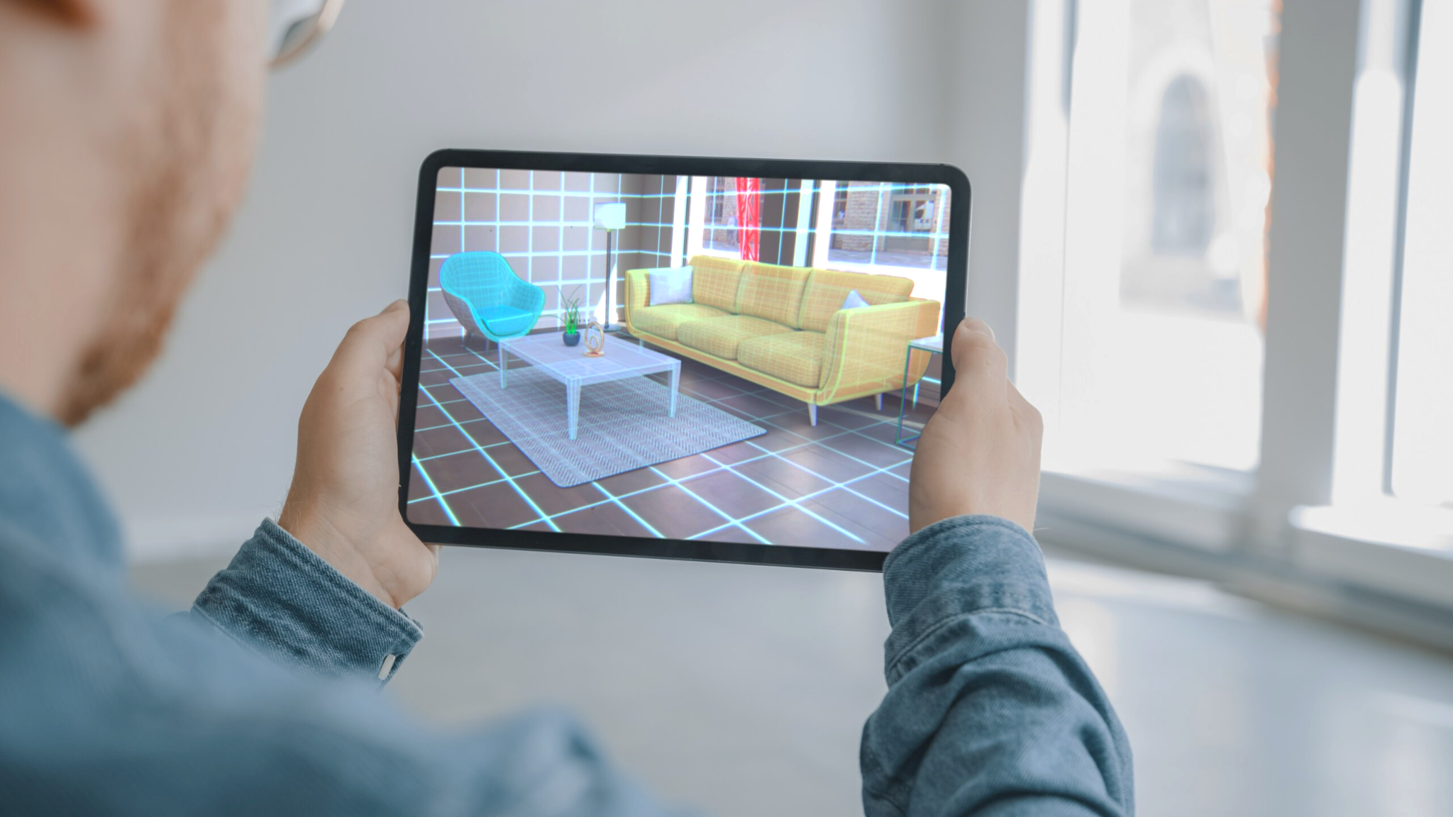
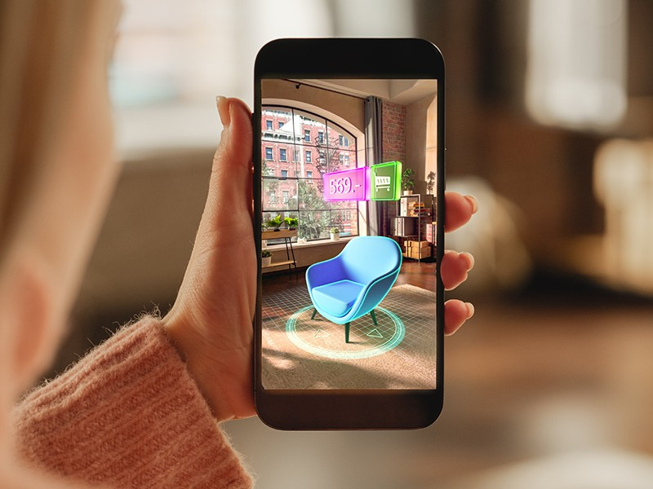
Background Information on Augmented Reality
AR (Augmented Reality) is a way of combining the real world with computer generated content.
AR based tools can be used in a variety of different industries including: Automotive, Education, Healthcare, and Retail.
Some Examples:
Virtual furniture placement
Virtual clothing/ accessory try ons
Virtual car technology

Slide 3
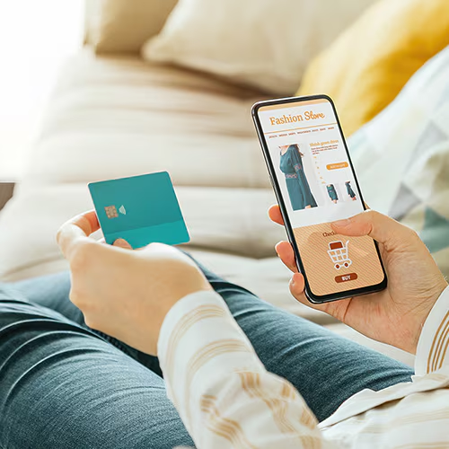
Online Retail
Customers are shopping more online
Convenient
Higher selection of items
Reviews and information
Retailers without a good online shop risk losing customers
Customers today shop more online than in stores
Image from: https://lifelock.norton.com/learn/internet-security/safe-online-shopping

Slide 4
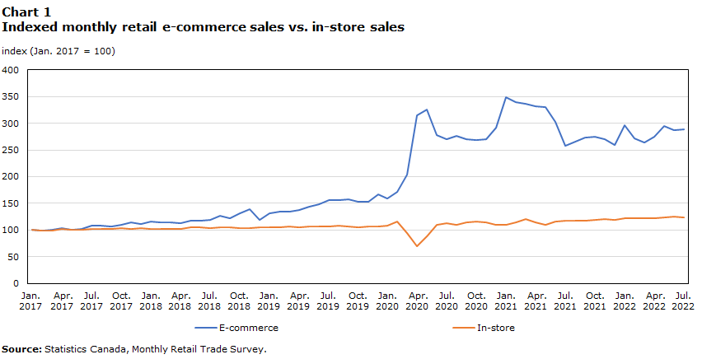
https://www150.statcan.gc.ca/n1/pub/11-621-m/11-621-m2023002-eng.htm

Slide 5
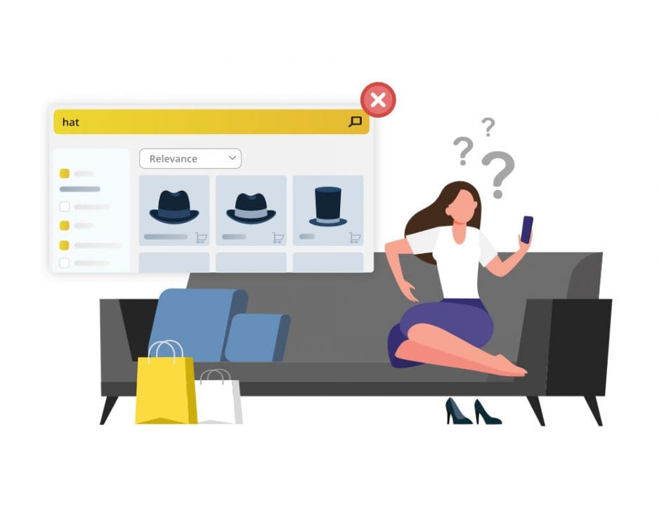
Limitations of Online Retail
E-commerce does not give customers the experience of trying on products in person.
Hard to tell what a product would look like on their body or in their home.
Uncertainty about size/fit/style.
Higher return rate and unsatisfied customers.
Image from: https://www.prefixbox.com/blog/online-shopping-problems/

Slide 6
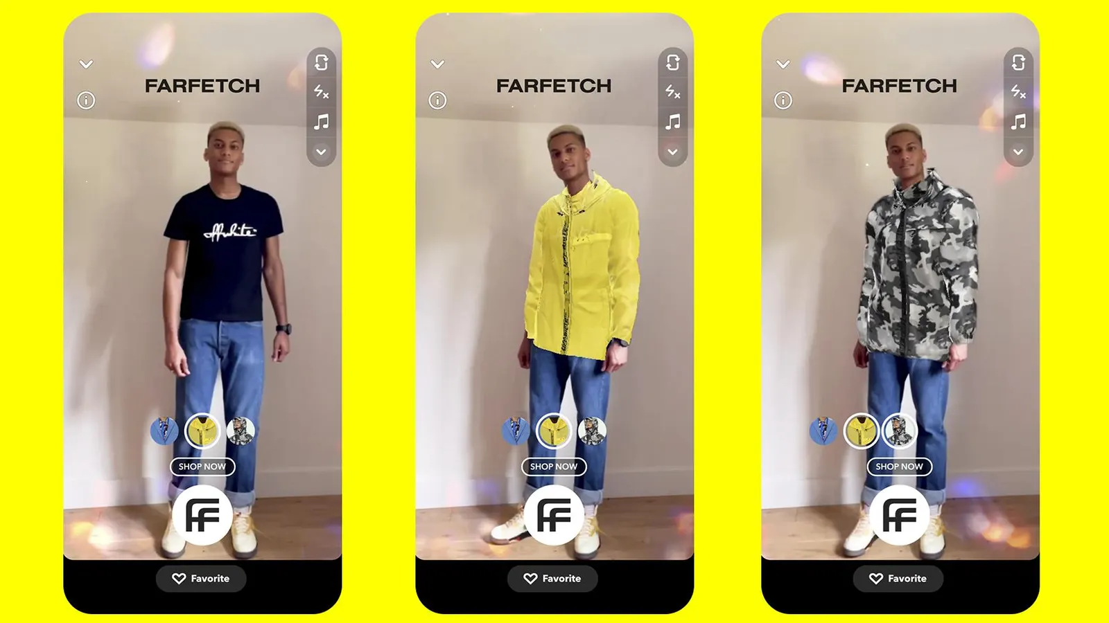
Our Product
Virtual try-ons
Lets customers try on clothing using their phones camera, from their home.
Smart AR mirrors
Analyzes customers preferences and body shapes through their phones camera to suggest items that fit them.
Image from: https://www.forbes.com/sites/lelalondon/2021/05/20/virtual-try-on-is-more-than-a-pandemic-trendand-these-brands-are-reaping-the-rewards/

Slide 7

Description of solution
AR provides virtual try-ons to help customers to be able to try the products on physically.
Enhanced visualization of the products helps in reducing errors and return rates.

Slide 8
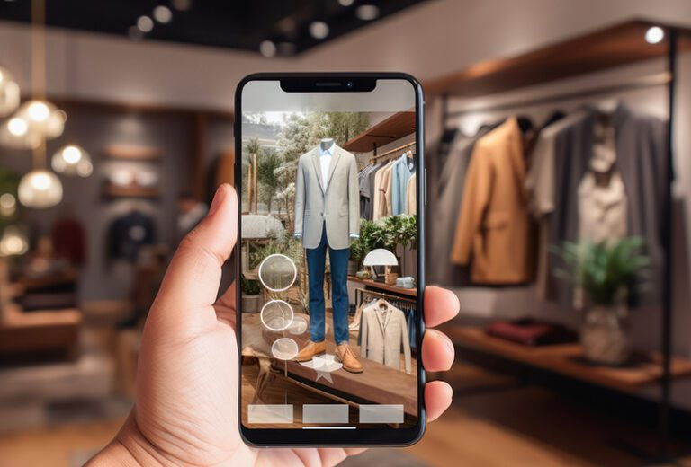
Description of solution (cont’d)
AR provides an interactive experience through the features to online users to help maintain an in-person experience.
Virtual AR mirrors helps provide a real time preview of the product visually which helps to prevent uncertainty.

Slide 9

Benefits of Augmented Reality in Retail
Improve Customer Satisfaction.
Increases Sales and Decreases return rate.
Image from:https://www.picamaze.com/wp-content/uploads/2020/10/GIF-sales-increase-Canva.gif
Notes:
Navjeet

Slide 10
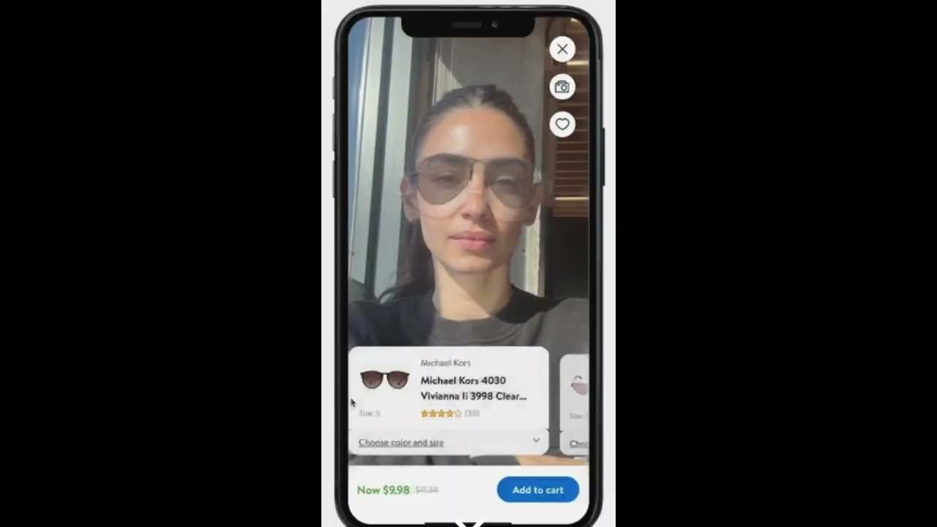
Benefits (cont’d)
Improve Customer Satisfaction
Create engaging and personalized shopping experience for customers.
Delivers information in an interactive and visually appealing manner.
Increases customer’s confidence in their purchase decisions.

Slide 11
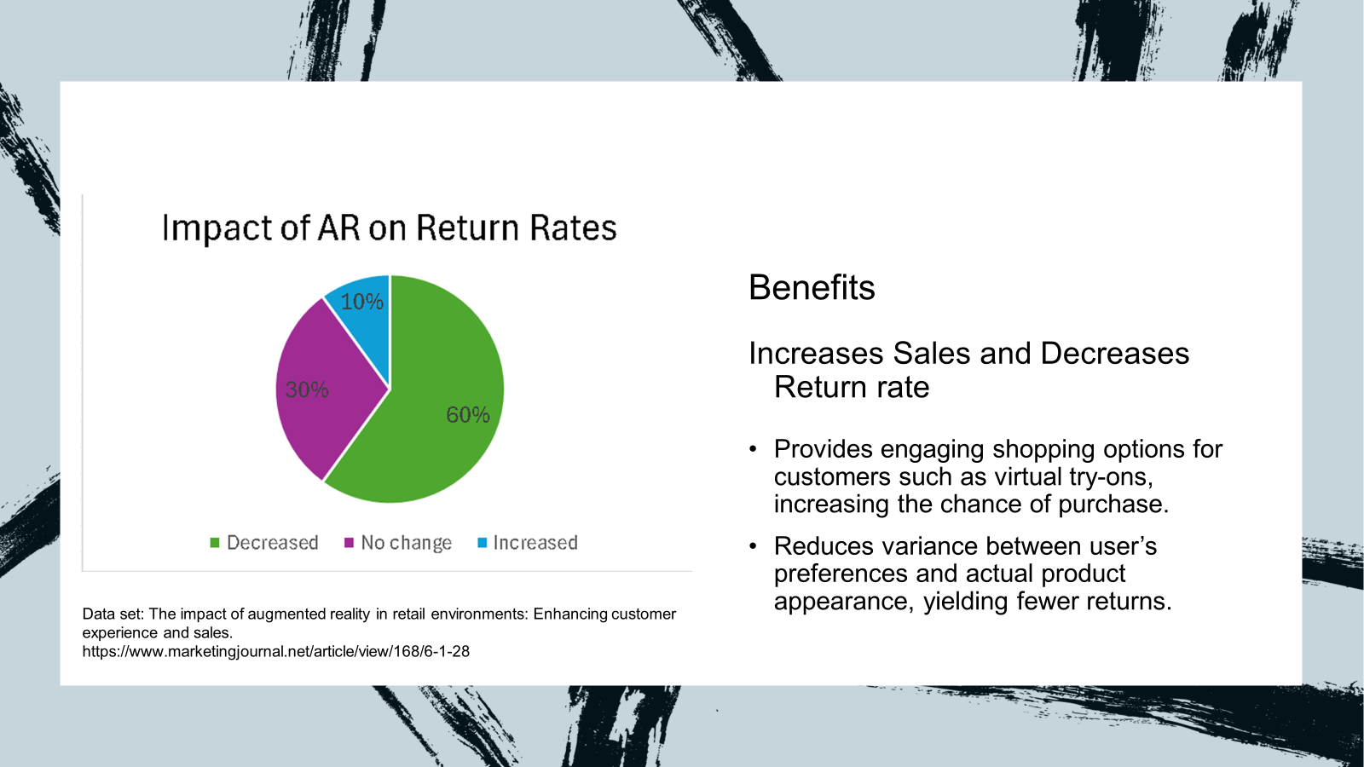

Slide 12


Slide 13
References
American Marketing Association, “JM Webinar: Augmented Reality in Retail and its Impact on Sales,” (January 26, 2022). Accessed: February 11, 2025. [YouTube]. Available: JM Webinar: Augmented Reality in Retail and Its Impact on Sales - YouTube
Zanzana, Salim, and Jessica Martin. “Retail E-Commerce and COVID-19: How Online Sales Evolved as In-Person Shopping Resumed.” Statistics Canada, 21 Feb. 2023, www150.statcan.gc.ca/n1/pub/11-621-m/11-621-m2023002-eng.htm
Dr. A. Kaur, “The impact of augmented reality in retail environments: Enhancing customer experience and sales,” International Journal of Research in Marketing Management and Sales, vol. 6, no. 1, pp. 189–194, Jan. 2024, doi: https://doi.org/10.33545/26633329.2024.v6.i1c.168. Available:https://www.marketingjournal.net/article/view/168/6-1-28

